Slide 1
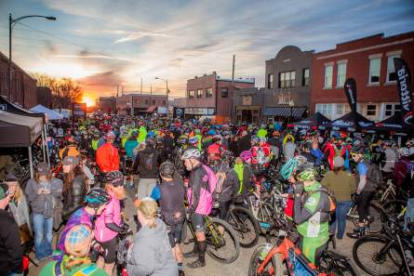
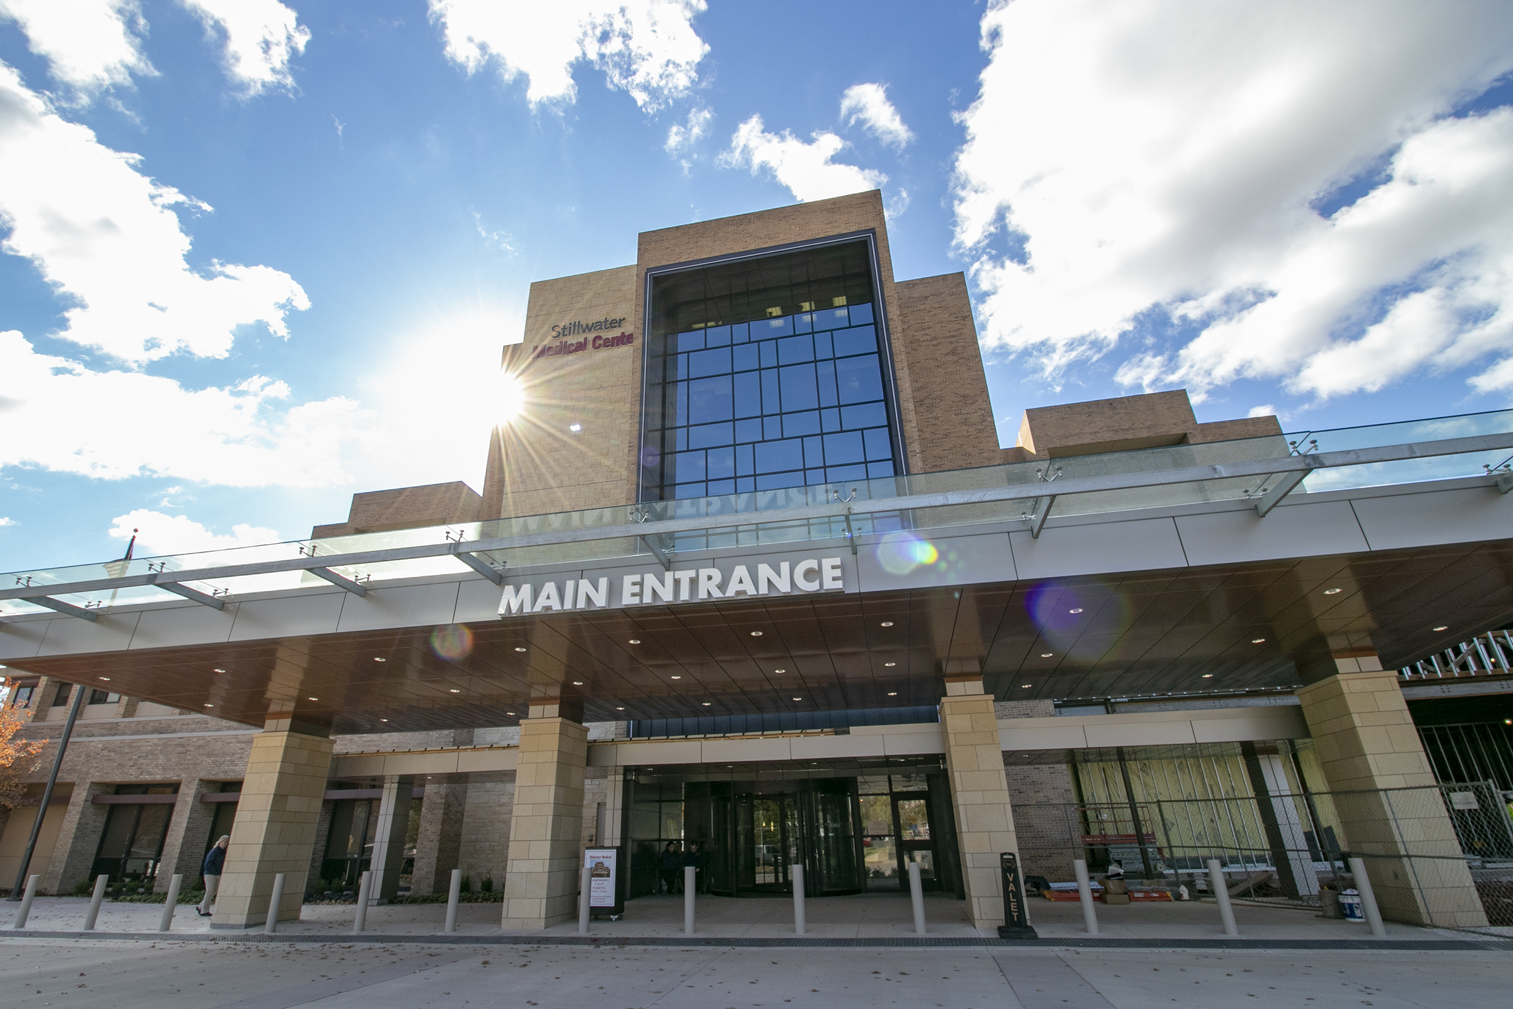
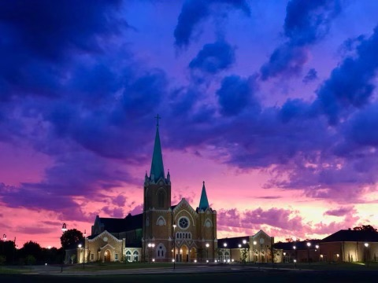
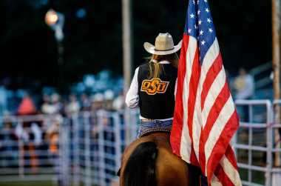
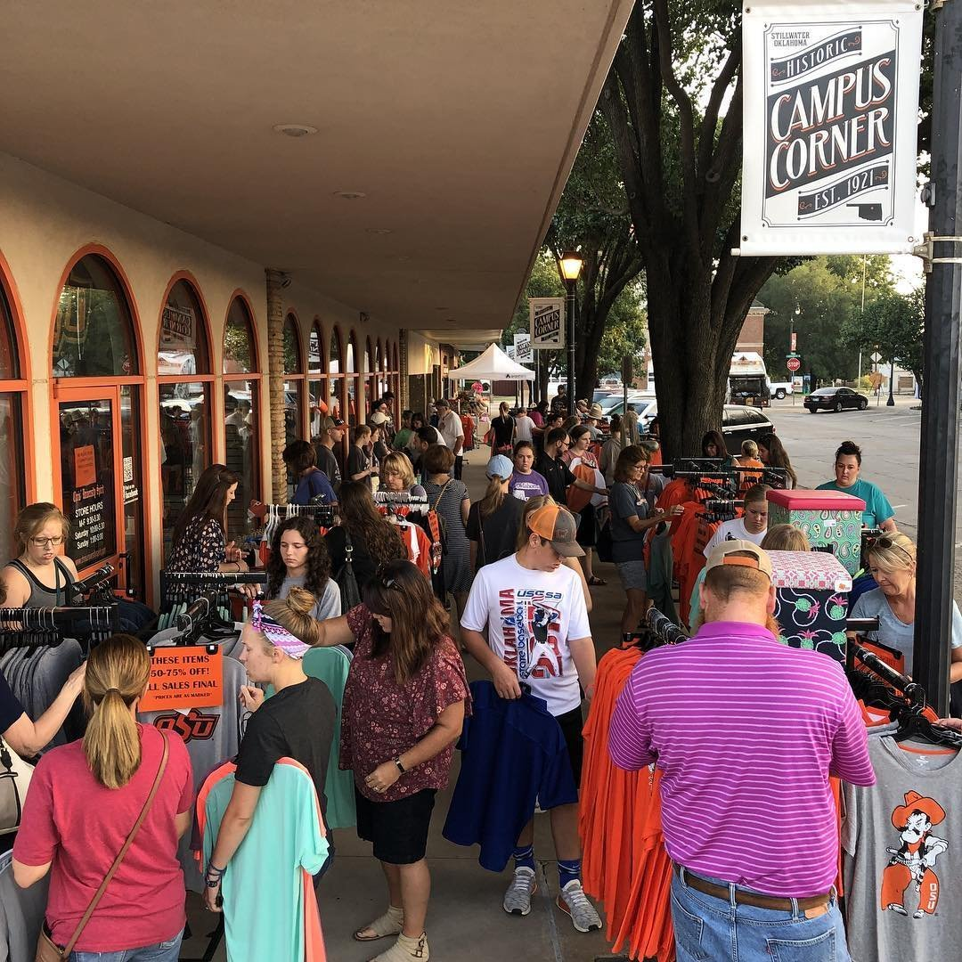

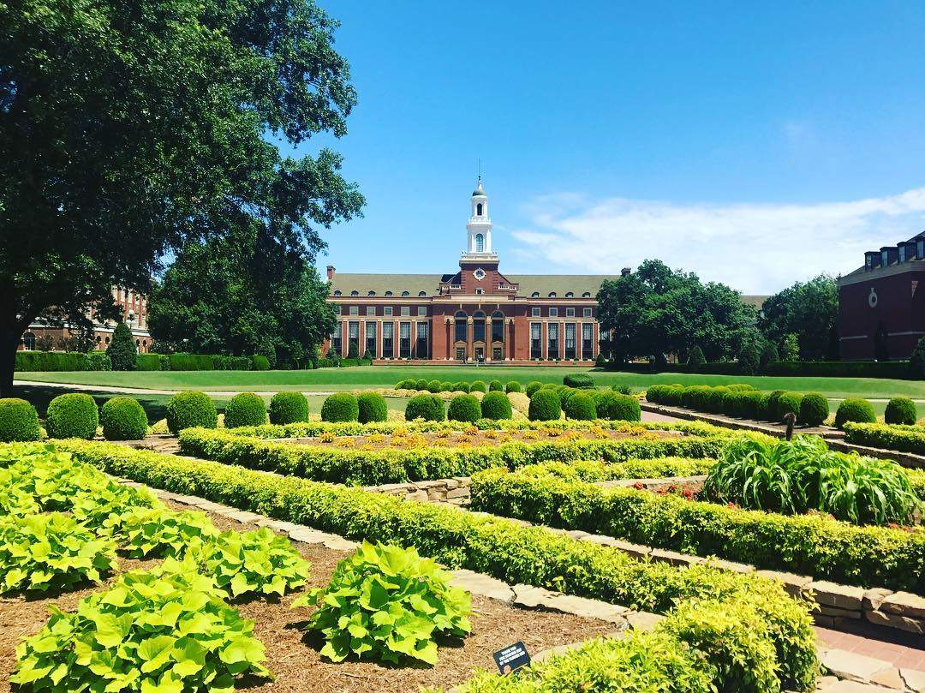
Vibrant Stillwater:
A Townhall
PICTURES

Slide 2
Vibrant Stillwater
Vibrant Stillwater is a coalition of citizens and leaders coming together to make our community stronger, healthier, and more vibrant through a shared vision and action plan.
We are working to create a citizen-inspired vision, get the community more involved in the process, and be intentional about our community’s development.

Slide 3
Vibrant Stillwater
Focus
July-Aug
Establish work Groups
Launch VS
Sept-Oct
Conduct Stillwater Survey
Share results
Nov-Jan
OSU Student Survey
Collect Ideas on Actions
Draft Action Plan
Create Dashboard
Identify Core Values & Form Steering
Launch VS and Quality of Life Survey
Share Results with Community
Engage with Citizens/Groups/Institutions on Ideas
Develop Action Plan for Citizen Driven Vision

Slide 4
Citizen Participation
Steering: Jeremy Bale, Gary Clark, Rebecca Eastham, Ed Gallegos, Bill Goodwin, Claudia Humpreys, Behfar Jananshahi, Alan Lovelace, Mike Moore, Norm McNickle, Ron Walker, Joe Weaver, Denise Webber, Chad Weiberg
Quality of Life Work Group: Jeremy Bale, Rachel Condley, Rebecca Eastham, Lindsay Fielding, Ed Gallegos, Stephen Gose, Claudia Humpreys, Jonathan Udoka,

Slide 5
Quality of Life Survey

Slide 6
What I hope you leave with:
Why the QOL Survey is important
The key steps in building a vibrant community
The 4 gears, when turning well create a better quality of life for the community
Next steps

Slide 7
OSU Positioning
Why OSU?
Academics & Research
OSU is a nationally ranked research university — in the classroom and on the field.
Top 50 Public Universities in America (Niche.com, 2018).
Most Truman Scholars (for graduate study in public service) in Oklahoma.
Honors curriculum listed top 10 in the nation (Willingham, 2018).
Academics Facts & Rankings
Affordability
As a land-grant institution, we believe access to education is an essential part of our mission.
Top 100 Best College Values (Kiplinger, 2017).
No. 76 (out of 4,000+) Best Public Schools for Scholarships (GoodCall, 2016).
Over 50% of OSU students graduate with zero student loan debt.
Affordability Facts & Rankings
Quality of Life
We invest in the well-being of our students, faculty, staff and community.
Largest comprehensive university student union in the world.
Students routinely log thousands of volunteer hours each year.
Located in America's friendliest college town.
Quality of Life Facts & Rankings

Slide 8



Building the Foundation:
Diagnose Before You Treat
Vibrant Community Assessment
Quality of Life
Dashboard

Slide 9






Burning Platform
Civic IQ
Vibrancy/
Downtown
Quality of Life
Economic
Development
Education

Slide 10
Population Growth

Slide 11
John Kotter
Burning Platform and Critical Mass
70% of failure is that the critical mass of companies do not have the same degree of urgency to achieve desired results as top leaders

Slide 12
Background and Research Objective
This survey was commissioned by Vibrant Stillwater, a coalition of citizens and leaders working to make our Stillwater stronger, healthier, and more vibrant through a shared vision and action plan. Vibrant Stillwater seeks to create a citizen-inspired vision, engage the community in the process, and be intentional about Stillwater’s development.
The Vibrant Stillwater creates community dialogue, conduct outreach and information sharing with the public, community leaders, business, and public policy makers.
Essential to the the Vibrant Stillwater’s mission, and the objective of this survey, is an understanding of the public’s awareness of and attitudes towards these issues and challenges.
That is the context in which the survey of Stillwater voters was conducted. These objectives are accomplished by the survey and are detailed in this report.
2021

Slide 13
Methodology
This poll was conducted by Mason-Dixon Polling & Strategy, Inc. of Washington, D.C. from September 13 - 27. A total of 500 registered voters, each of whom resides in the Stillwater Independent School District, as the school district boundaries more appropriately define the ”community” in relation to the goals and objectives of Vibrant Stillwater. Voters were interviewed by telephone.
Those interviewed were selected randomly from a commercially available Oklahoma State voter registration file. The resulting sample fairly reflects the demographic profile of registered voters in City of Stillwater.
The margin for error, according to standards customarily used by statisticians, is no more than plus or minus 4.5 percentage points. This means that there is a 95 percent probability that the "true" figure would fall within that range if the entire population were sampled. The margin for error is higher for any subgroup, such as a gender, income or race.
2021

Slide 14
Demographics

Slide 15
Stillwater: Right Track/Wrong Track
Do you think that the City of Stillwater is heading in the right track, or are things on the wrong track?

Slide 16
Most Important Issue Facing the City of Stillwater
COVID/PANDEMIC |  |  | 34%
TRAFFIC/ROADS |  |  | 26%
ECONOMY |  |  | 11%
POOR LEADERSHIP |  |  | 7%
PUBLIC EDUCATION |  |  | 6%
CRIME |  |  | 1.6%
DOWNTOWN |  |  | 1.4%
LACK OF CULTURE |  |  | 1.4%
TAXES |  |  | 1.2%
HEALTH CARE |  |  | 1.2%
OTHER |  |  | 4.80%
NOT SURE |  |  | 4%

Slide 17
Rating Economic Conditions in Stillwater
Five years from now, do you think that the economy in the City of Stillwater will be better off, worse off, or about the same as it is today?
How would you rate economic conditions in City of Stillwater?
Total Positive
Total Negative

Slide 18

Level of Concern about Personal Job Security
How concerned are you about the security and future of your own job, or the jobs of any
close family members in City of Stillwater?
Total Not Concerned
Total Concerned

Slide 19
Rating Quality of Life Factors
“I’m going to read a list qualities and characteristics that contribute to the quality of life in a community. Please tell me how you rate each in the City of Stillwater, excellent, good, only fair, or poor.”

Slide 20
Rating Quality of Life Factors
Total Positive
Total Negative

Slide 21
Rating Quality of Life Factors
Total Positive
Total Negative

Slide 22
Familiarity with Vision, Plans, and leadership for Economic Development
Statement read to respondent: “Economic Development generates investment, wealth, tax base and jobs from which many community benefits are created.”
I am familiar with the vision and plans for community development in the City of Stillwater?

Slide 23
Familiarity with Vision, Plans, and leadership for Community Development
Statement read to respondent: “Community Development generates solutions to problems, like housing, education, transportation and neighborhood renewal, making the community a better place to live and work..”
I am familiar with the vision and plans for community development in the City of Stillwater?
AGREE
DISAGREE

Slide 24
“Now please rate City of Stillwater as a place to live for the following types of people”
Total Positive
Total Negative

Slide 25
Rating the Overall Quality of Life
How would you rate the overall quality of life in City of Stillwater?

Slide 26
Over the next 5 years do you think that the quality of life in City of Stillwater will improve, deteriorate or stay about the same?

Slide 27
Out-Migration
How likely are you or an immediate family member to move from the Stillwater area in the next 5 years; very likely, somewhat likely, not very, or not at all likely?
Reasons given for moving from area
(of the 36% saying they are likely to leave)
POOR JOB MARKET |  |  | 47%
POOR ECONOMY |  |  | 33%
POOR SCHOOLS |  |  | 1.1%
POOR LEADERSHIP |  |  | 3.3%
LACK OF CULTURE/ENTERTAINMENT |  |  | 3.3%
OTHER |  |  | 9.4%
NOT SURE |  |  | 2.8%

Slide 28
Vibrant Stillwater
Have you heard of an effort called Vibrant Stillwater, and if so, do you have a favorable or unfavorable opinion towards it?
FAVORABLE | 10%
UNFAVORABLE | 3%
HAVE HEARD NAME – NO OPINION | 30%
OF THE 43% WHO HAVE HERARD OF VIRBRANT STILLWATER

Slide 29
Vibrant Stillwater
Successful efforts to improve the quality of life requires community input, a shared vision, planning and transparency.
Here’s a brief statement:
Vibrant Stillwater is a coalition of citizens and leaders coming together to make Stillwater stronger, healthier, and more vibrant through a shared vision and action plan. Their first action was the commissioning of this Quality-of-Life Survey to better understand the needs and desires of Stillwater residents and to inform the development of a shared vision and strategic plan of action. This coalition includes private citizens and leaders from the City of Stillwater, School District of Stillwater, OSU, and Stillwater Medical Center.
The involvement of the City of Stillwater, its leading institutions, and the community at large is critical to address and improve quality of life issues for all of residents.

Slide 30
Vibrant Stillwater
Based on what you’ve information you just heard:
“Do you support the concept, effort and the mission of Vibrant Stillwater?”

Slide 31
“With these results you have been given a mandate. 70% of respondents say you are moving in right direction. 92% support Vibrant Stillwater efforts.” - Larry Harris, Mason - Dixon

Slide 32
Takeaways
Moving the Good to Excellent
Celebrating what is right
Attracting and retaining young people
Building stronger entrepreneur environment
Creating a vibrant downtown
Lifting up people who live below the poverty line

Slide 33

Never Underestimate the Difference You Can Make​
​
- Quint Studer

Slide 34
Next Steps
Sign up for updates at www.vibrantstillwater.com
Email or Reach out to Steering / Work Groups to have results presented to a group or organization
Share Results through social media, radio, press #vibrantstillwater, #poweredbycitizens #qualityoflife
Ask questions at Info@vibrantstillwater.com
TEXT Stillwater
22-999
FOR LINK

Slide 35

Vibrant Stillwater
Together, defining what we will become

